Slide 1
The Computer System
Computer Types

Slide 2
The Computer Types
Basically there are two basic types of computer :
Analog Computer
The function is to measure, to represent number (measuring electricity, temperature etc)
Digital Computer,
The basic idea is to count, by using a series of digits
Hybrid Computer, (analog and digital)
Most current computers are digitally
More accurate
Faster
Cheaper
Better performance

Slide 3
The Computer Types
Analog Computer
Computer that uses continuous-changeable aspects of physical phenomena such as electrical, mechanical, or hydraulic quantities to model the problem being solved.
Developed from the transistor technology
Commonly used before the digital technology developed sufficiently
Current-ly they have moved to digital technology
Usually is used to solve a non-analytic differential equation problem, for use at some stage of an overall computation (where precision is not very important).

Slide 4
The Computer Types
Digital Computer,
A digital computer is an electronic computing machine that uses the binary digits (bits) 0 and 1 to represent all forms of information internally in digital form.
Digital computers represent varying quantities incrementally, as their numerical values change.
The digital computer—or simply, computer—embraces calculators, computer workstations, control computers (controllers) for applications such as domestic appliances and industrial processes, data-processing systems, microcomputers, microcontrollers, multiprocessors, parallel computers, personal computers, network servers, and supercomputers

Slide 5
The Computer Types
Hybrid Computer, (analog and digital)
Computers that use analog computer in front-end and fed the value into a digital computer using an iterative process to achieve the desire degree of precision
Hybrid computers converts analog output into digits.
Hybrid computers are used to obtain a very accurate but not very mathematically precise 'seed' value,
The hybrid computer is usually substantially faster than a analog computer, but can supply a far more precise computation than an analog computer.
It is useful for real-time applications requiring such a combination (e.g., a high frequency phased-array radar or a weather system computation)

Slide 6
The Type Of Computer
From the Size Point of View :
Micro Computer
Mini Computer, examples
  Various Severs
Medium Computer
  IBM Risc 6000
  IBM Server
Mainframe, examples
  IBM AS 400
  IBM Regata P690
  IBM Regata P590

Slide 7
The Type Of Computer
From the Size Point of View :
Micro Computer
  PC (desktop), Laptop etc are the examples
  Mostly for personal uses, though the capacity and capability is getting greater
  Composed of CPU, Monitor & keyboard, and some of them are made in a compact form
  Tend to have affordable price for a family
  The trend is in the form of portable one
Mini Computer
  A mid size computer
  Much more similar to the micro than mainframe
  In the form of server
  Able to perform multi function and multi tasking concurrently
  Offer users a number of different languages
  Usually connected to the auxiliary storage devices that has been different than micro computer
  The auxiliary storage usually reflects the size and capability

Slide 8
The Type Of Computer
From the Size Point of View :
Mainframe
  The largest general purpose of computer
  Most powerful and high scalability both in memory, process, speed and storage
  Have the capability to retrieve and process at once
  Have the capability to process many different application and different users
  Many different language might be handled by this system

Slide 9
The Computer Languages
Needs by computer to activate the system, and to communicate with other system correctly
Computer is not human being that has creativity and initiatives to communicate, there must be instruct the computer to do
Computer language that is set in the program, who instruct the computer to do

Slide 10
The Type of Computer Languages
Just as human being use language to communicate with, so do computer.
There are three level of Computer language in the computerization :
  Machine language, this language very difficult (most medium to mainframe)
  Low level assembly language, easier than machine language
  High level programming languages, easiest and closest to human being languages

Slide 11
The Computer Languages
Machine language
  A particular language of a specific computer.
  Written in a binary code
  Machine language is machine dependent, need to be developed for every platform.
  Machine language program work very quickly, also more economical than other program in term of storage space
Symbolic Computer Language:
  A little bit different to a machine language.
  Do not use binary code, but use a type of code
  Easier to read and write than those of machine language

Slide 12
The Computer Languages
Assembly language
  Called low level programming language because closer to machine language.
  Assembly language is machine dependent, almost closed to machine language
  Efficient for programmer to write
  Economics on storage space and are executed quickly
Programming Language:
  Called high level programming language, because close to human language.
  Not as related to characteristic of a particular computer, more universal
  Easier to user
  Might focus on solving program than having to worry about internal characteristic of the computer

Slide 13
The Computer Languages
Programming Language example
  COBOL
  Fortran
  MS Basic
  PASCAL
  Progress
  MS Access
  SAS
  Oracle
  C
  etc

Slide 14
Common Practices
References in implementing IT Services
  COBIT - Control Objectives for Information and related Technology
  IT governance framework and toolset that allows managers to bridge the gap between control requirements, technical issues and business risks
  ITIL - Information Technology Infrastructure Library
  A set of good practices for IT service management (ITSM) that focuses on aligning IT services with the needs of business.
  BS 25999 – British Standard reference for Business Continuity Management
  ISO for IT Services
  Other reference such as PBI

Slide 15
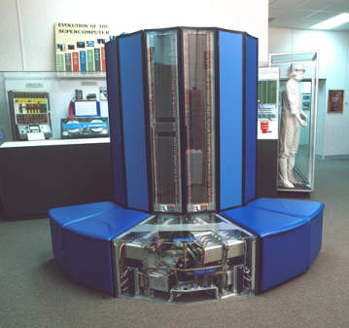
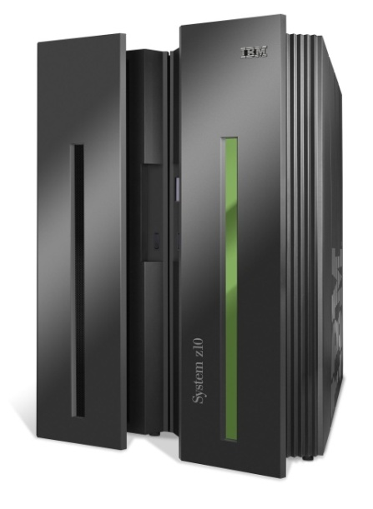

Slide 16
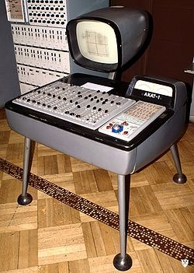
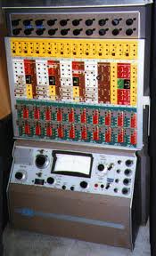
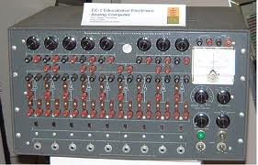
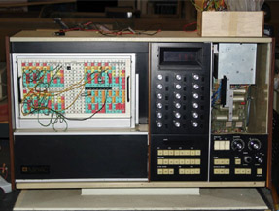

Slide 17
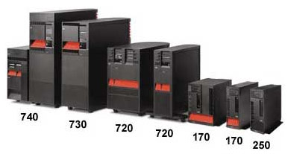
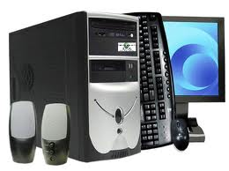
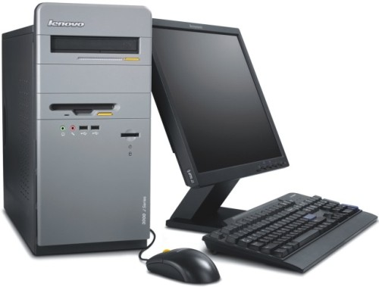

Slide 18
